Slide 1
LEARNING PROXIMITY RELATIONS FEATURE SELECTION

Slide 3
MODULES DIAGRAM:
1.User Interface Design:
Welcome to Login
Server
User
Login
Register
New user

Slide 8
if(m==true)
{
response.sendRedirect("fileupload.jsp");
}
else
{
response.sendRedirect("missmatch.jsp");
}
}
}

Slide 13
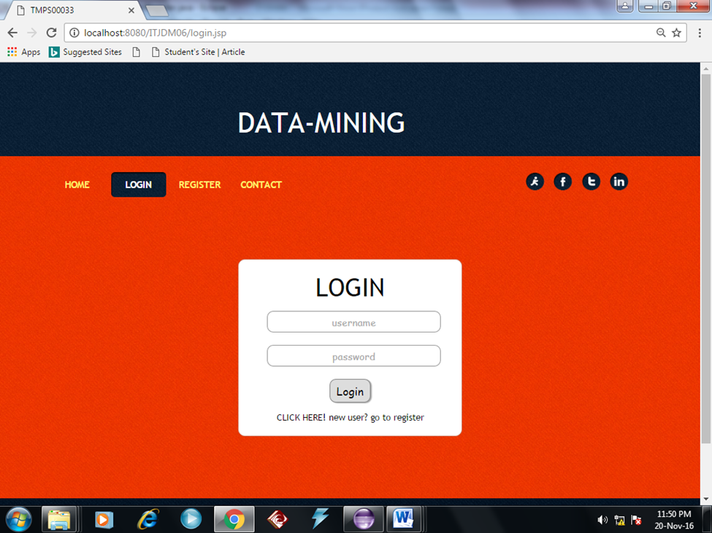

Slide 14
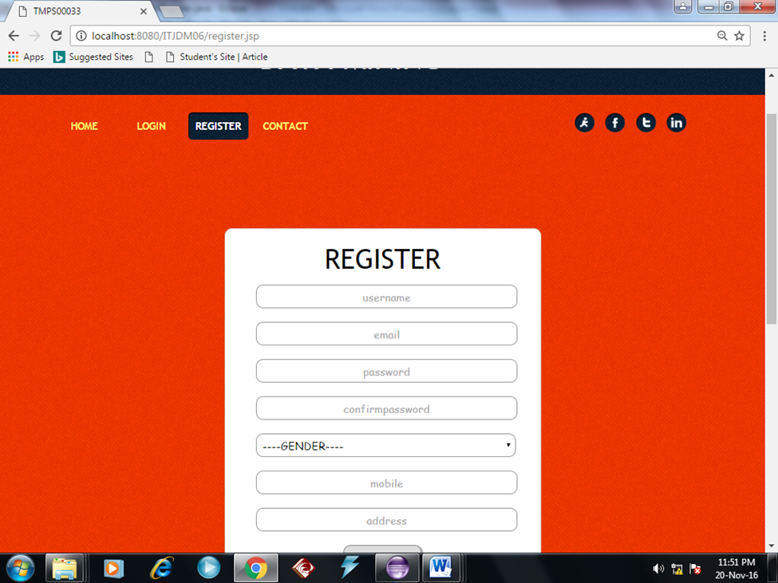

Slide 23
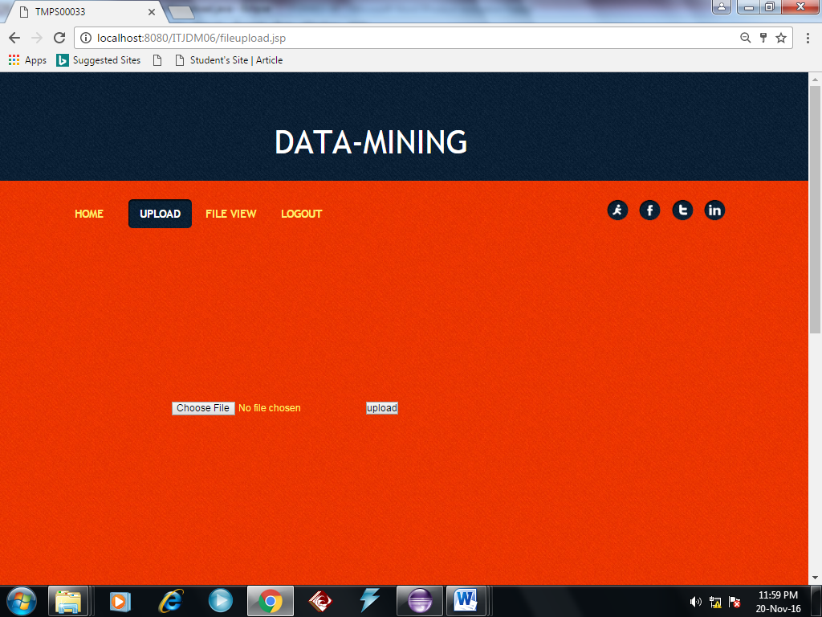
Notes:
EXPLANATION:
The main purpose of a use case diagram is to show what system functions are performed for which actor. Roles of the actors in the system can be depicted. In our use case diagram first cloud user login into cloud. Here uploading his constraints to cloud provider. The cloud provider took the cloud user request and sent to Interaction model we divide a file into fragments, and replicate the fragmented data over the cloud nodes. Each of the nodes stores only a single fragment of a particular data file that ensures that even in case of a successful attack, no meaningful information is revealed to the attacker.

Slide 24
Notes:
EXPLANATION:
The class diagram is the main building block of object oriented modeling. It is used both for general conceptual modeling of the systematic of the application, and for detailed modeling translating the models into programming code.
In class diagram took the cloud user, cloud provider and consumer. In cloud user we took the user login and user constraints. We divide a file into fragments, and replicate the fragmented data over the cloud nodes. Each of the nodes stores only a single fragment of a particular data file that ensures that even in case of a successful attack, no meaningful information is revealed to the attacker.

Slide 25
Notes:
EXPLANATION:
Object diagram we are telling about the flow of objects how the process is running. In the above digram tells about the flow of objects between the classes. The main object of this diagram is cloud user login his window and send the his constraints to cloud. We divide a file into fragments, and replicate the fragmented data over the cloud nodes. Each of the nodes stores only a single fragment of a particular data file that ensures that even in case of a successful attack, no meaningful information is revealed to the attacker.

Slide 39
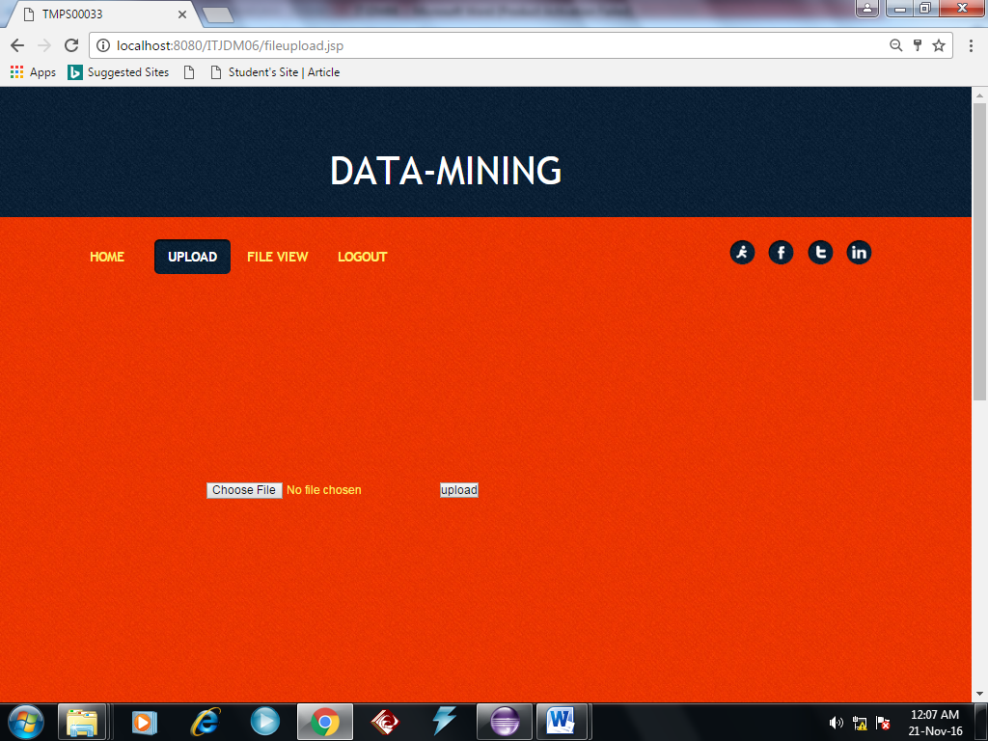

Slide 46
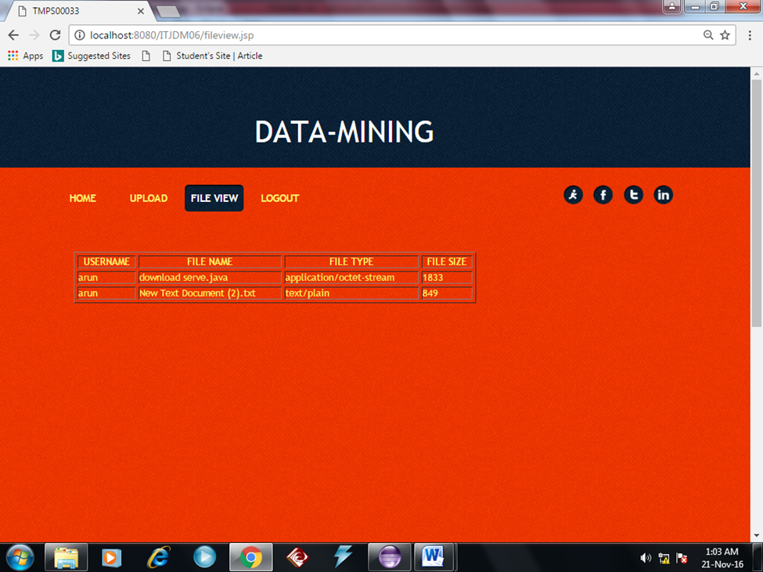

Slide 47


